Slide 1
Levy Roarke
Levy Mozes Roarke is a thirteen year old inventor who is trying to make history and save his family from losing everything they have. He never dreamed he would initiate a time war that might very well decide the fate of us all. The truth is no matter how this story turns out not one will ever look at history the same.

Slide 2
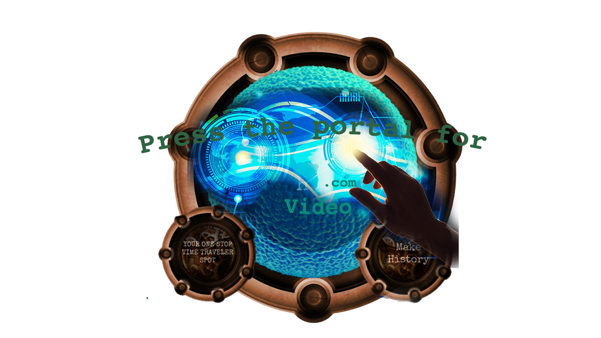
A Musical Tribute
I made this playlist on Spotify to describe Levy Roarke’s character, emotions, and journey through time. Each song was carefully picked because I wanted my audience to better understand Levy and connect with him and his story. All of these songs used in the playlist are sited and used only to describe my character for our audience to better understand his character.
Any time you see a time portal like this click and listen the song related to Levy’s adventure in Chronolocity: A Fistful of Chrontons.
Listen the whole playlist here

Slide 3
Song 1: Superman
by Five for Fighting
When we first meet Levy he is struggling with being the hero his family needs. Levy and his dad have both played the hero and if hasn’t always turned out so great. There is a line in the song that says, It may sound absurd, but don't be naive/ Even heroes have the right to bleed/I may be disturbed, but won't you concede/ Even heroes have the right to dream/ And it's not easy to be me. Levy and his family are living with his dad’s attempt to save another person, but he lost his job doing it.

Slide 4
Song 2: Girl of My Dreams
by Brandon Heath
Levy is rather shy especially when it comes to girls. That is when he clams up and doesn’t know what to say. But after meeting Elise Quinonez face-to-face that all changes. The song talks about seeing your dreams come true in a relationship, but the real people come out. “We spend some nights just eating ice cream and watching Netflix,” reminds me that love exists in the ordinary moments of life. One of Levy’s dreams was to meet the right person someday. Could Elise be the one he has been looking for?

Slide 5
Song 3 What Faith Can Do?
by Kutless
Being more logical and left-brained, the idea of having faith doesn’t always compute with Levy’s computer-like mind. He doesn’t even like listening to his emotional side. So, as Levy is put in numerous situations where he has to use faith and this becomes an issue that he has to decide how to face. A line in this song really breaks down Levy’s thoughts: “It doesn't matter what you've heard/ Impossible is not a word/It's just a reason for someone not to try.”

Slide 6
Song 4: Enterprising Young Men
by Michael Giacchino
Levy Roarke is not your typical thirteen year old boy. He always has ideas brewing in his curly head 247. This is good and bad especially when it keeps him awake at night. When I listen to this song, from Star Trek I think of Levy boldly going on his own journey to change the world. Even though he feels like he has the worst luck in the world, fails at so many inventions, and runs from his real destiny the future knows he will make us mark on history.

Slide 7
Song 5: Stuff We Did (Theme from UP)
by Michael Giacchino
Two people who heavily influenced his young life are his Grandpa and Grandpa Heiter. They are two Holocaust survivors who always were a part of Levy’s life. After his Grandpa’s death, Levy feels like he has lost his biggest encouragement in the world. This song from the movie UP, makes me think of the life his grandparents must have had and the influence they still make in Levy’s life.

Slide 8
Song 6: Let it Go
by Chaos and the Calm
Along Levy’s journey through time, he meets historical figures in the form of their younger more impressionable selves. One such person is Annie Oakley. Though only able to communicate with Morse Code and never seeing each other’s faces, they bond as friends. Levy does confide in her and share his real struggles in his life. If Annie knew the lyrics from this song, I think she would have found a way to share them with Levy. “So come on, let it go/ Just let it be/ Why don’t you be you/ And I’ll be me/ Everything that’s broke/Leave it to the breeze/ Why don’t you be you/ And I’ll be me.

Slide 9
Song 7: Little Talks
by Monsters and Men
During Levy’s adventure in time, he meets H & E. They are a pair of time travelers who have come to prepare him for future events. His world is spun upside down as he is recruited by them to help correct history which is being subtly augmented. Little Talks reminds me of the life of a nerd or creative. They think and act differently than others, but without them the world would never be the same. H knows how to talk to Levy as a fellow out-of-the-box thinker and she does her best to encourage his sense of being a hero. After their little pep talk, Levy has a lot to think about before moving forward in his life.

Slide 10
Song 8: Holding Out for a Hero
by Bonnie Tyler
Everyone is looking for someone to bite the bullet and have Levy stop avoiding his destiny. Being a hero is in his blood, but when someone calls him one it makes his anger boil. When the song says, I’m holding out for a hero/ ‘til the end of the night/ He’s gotta be strong/ and he’s gotta be fast/ and he’s gotta be fresh from the fight/ I think that scares Levy. He knows he is not of these, but still feels the burning in his heart to do the right thing in the way he is meant to be the hero that all of history needs.

Slide 11
Song 9: Thank You for Being a Friend
by Andrew Gold
I stumbled upon this great 70’s song that is really a tribute to friendship. Levy Roake may or may not realize the impact he makes on people. He seems to make friends wherever he goes. During his time in the past, he befriends Tom Edison, Junior (Martin Luther King Junior) and a very quiet boy named Albert. Even though it might affect the timeline they all risk becoming friends in order to protect the future.

Slide 12
Song 10 : Meant to Be
by J. J. Keller
In an odd turn of events, Levy meets one of his favorite female heroes, Annie Oakley. Something about her brave courageous spirit, her determination, and overcoming difficult circumstances really touches. You could say Levy has a historical crush on Annie. The song, Meant to Be talks about two people who are perfect for each other and it’s a sweet thing to witness. Even though they both understand each other, love the same things, and sort of complete each other, they are both separated by more than a century. Their friendship could be disastrous for the timeline as we know it. So, this song is actually the opposite of what they both wish could happen.

Slide 13
Song 11 Take Me Home Country Road by John Denver
Everyone has their own learning style. Some are very visual, others learn by hearing, some by communicating with people. Others like Levy Roarke are tactile learners. What is that you might ask? They are people who learn with their hands, who understand things better when they can hold, touch, or use senses to experience things. Levy uses this skill to invent, create and discover the world with his two hands. In this song, John Denver uses very descriptive language to help the listener understand his love for nature. He shared lystics like these: All my memories gather ‘round her/ Miner’s lady, stranger to blue water/ dark and dusty, painted on the sky/ misty moonshine, teardrop in my eye/. Levy may not care for nature as he does for technology, but he would understand this descriptive language.

Slide 14
Song 12: Pure Imagination by Gene Wilder
This may very well be the song that inspired me as a writer to create the character of Levy. He and Willy Wonka are both dreamers who are passionate about seeing their dreams come true. If you want to see paradise/ simply look around a view it/ anything you want to, do it/ want to change the world? / There’s nothing to it. Levy’s future goal is to have his own creative company and learning about others’ dreams becoming reality inspires him to not give up when it gets difficult.

Slide 15
Song 13: The Break up Song by Francesca Battestelli
One HUGE obstacle that Levy faces is fear. He is worried, even at a young age that he might miss his opportunity to have his invention make him famous. Little did he know that it would propel him into a time war and that he would have to choose a side. In this song, the singer is telling fear to leave her life, just like breaking up a bad relationship. She chooses faith over fear. The question is after all he knows about the past, the present and a glimpse into the future, while Levy choose faith over fear?

Slide 16
Song 14: If We’re Honest by Francesca Battestelli
Levy keeps a lot of secrets, worries and troubles to himself. He isn’t sure who he can trust and confide in. But what he gets is a real taste of real honest truth in the time traveling Henna. She has a way of helping Levy build his trust back and not be so fearful. I could see Henna singing this stanza from the song: Bring your brokenness, and I’ll bring mine/ ‘Cause love can heal what hurt divides/ And mercy’s waiting on the other side/ If we’re honest/ If we’re honest.

Slide 17
Song 15: Dream Small by Josh Wilson
Levy comes to realize that his big plans might take time to come true. Instead of taking giant steps, maybe it’s the day-by-day situations that bring about success. Maybe the dream is ready, but the dreamer needs to grow into their role? Dream small/don’t buy the lie you have to do it all/ Just let Jesus use you where you are/ one day at a time/. After Levy’s trip through time, he is beginning to see what makes a real hero, how a dream really develops, and what faith in the real issues of life looks like.

